Slide 1
23/06/2022
Title: Reading timetables
Aim:
Read timetables using the 24-hour clock.
Calculate time intervals.
Given a time delay, count on to find new train departure and arrival times.

Slide 2
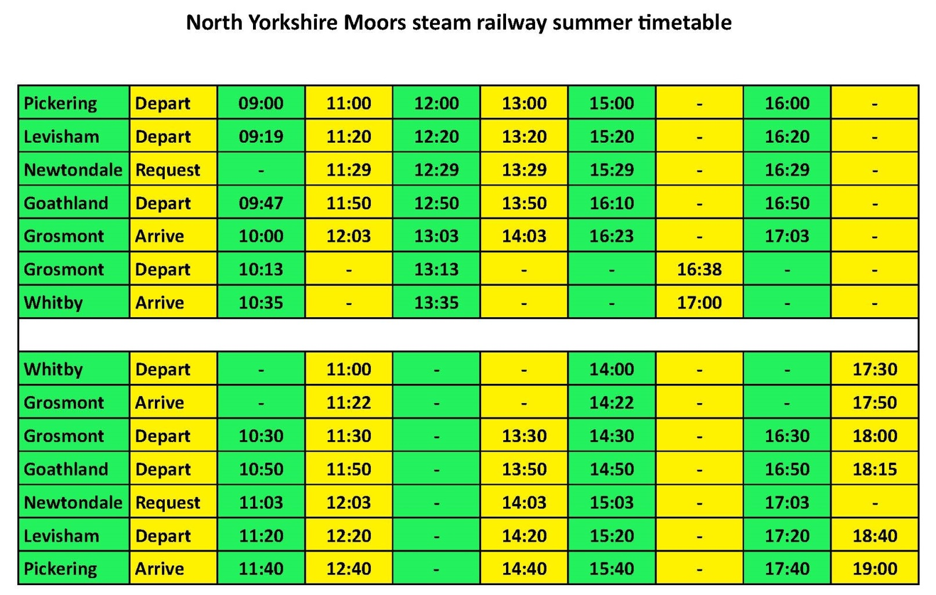

Day 3: Read timetables using the 24-hour clock; Calculate time intervals.
North Yorkshire Steam Railway runs steam trains from Pickering across the moors to Whitby on the coast.
Hikers can get off on the moors to go walking, or holiday-makers can get the train to the seaside at Whitby.
Write ringed times as 12-hour times.
Notes:
If desired, you could show details of each stop at http://www.nymr.co.uk/planning-your-visit/line-guide/.

Slide 3

Day 3: Read timetables using the 24-hour clock; Calculate time intervals.
A family want to catch the first train from Pickering to Whitby, and catch the last train back so they can have a full day at the seaside.
We’re going to find out how long they can spend in Whitby.
What should we mark on the time-line?
Notes:
Agree what time the family will arrive and what time they need to depart.

Slide 4
Day 3: Read timetables using the 24-hour clock; Calculate time intervals.
Arrive in Whitby at 10:35.
Leave Whitby at 17:30.
They can stay in Whitby for 6 hours 55 minutes.
6 hours
30 mins
25 mins
10:35
11:00
17:00
17:30
6 hours + 25 mins + 30 mins = 6 hours 55 mins
Notes:
Some children may feel confident in jumping from 11:100 to 17:30 in one jump.

Slide 5
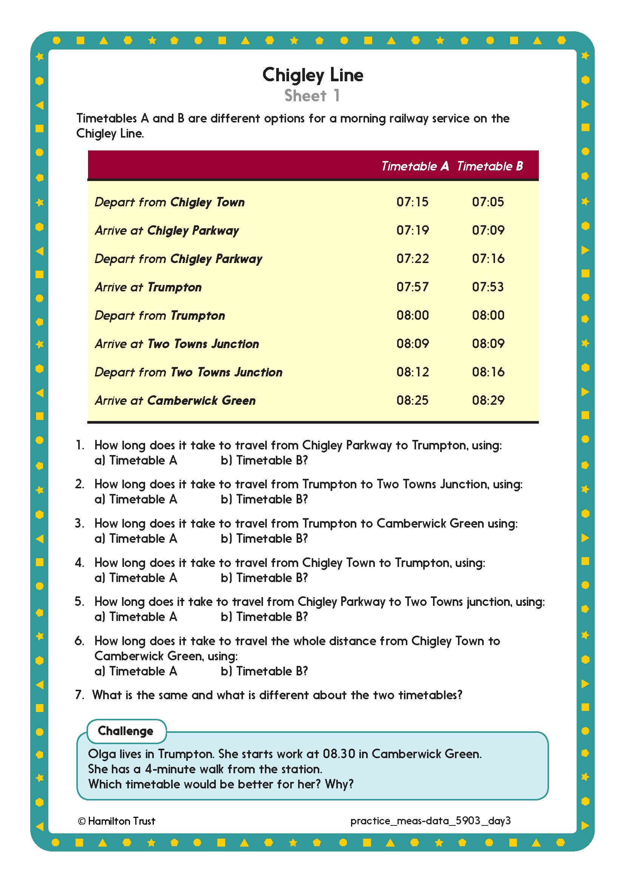

Challenge
Notes:
The Practice Sheet on this slide is suitable for most children.
Differentiated PRACTICE WORKSHEETS are available on Hamilton’s website in this unit’s PROCEDURAL FLUENCY box.
WT/ARE/GD: Interpret a fictional timetable, including calculating elapsed times (Sheet 1).

Slide 6
Measures and Data
Read timetables using 24-hour clock
Calculate time intervals
Objectives
Objective 4
Given a time delay, count on to find new train departure and arrival times.

Slide 7
Day 4: Given a time delay, count on to find new train departure and arrival times.
The 14:48 to Birmingham New Street is running approximately 37 minutes late as a result of sheep on the line near Worcester.
How will we calculate the new departure time?
How many minutes to the next hour?
How many minutes do we need to add?
12 mins
25 mins
14:48
15:00
15:25
So this is the time that the train is now expected to depart.

Slide 8
Day 4: Given a time delay, count on to find new train departure and arrival times.
The train to Gloucester, due to depart at 18:52, is running approximately 45 minutes late as a result of signalling problems.
Calculate the new departure time.
The 13:53 to Penzance is running approximately 1 hour and 15 minutes late as a result of stormy weather conditions causing flooding.
Calculate the new departure time.
Notes:
Observe and support children making jottings on an empty number line.
Children can now go on to do differentiated GROUP ACTIVITIES. You can find Hamilton’s group activities in this unit’s TEACHING AND GROUP ACTIVITIES download.
WT/ARE/GD: Use ‘counting on’ on a number line as a strategy for adding a time duration to a start time.

Slide 9
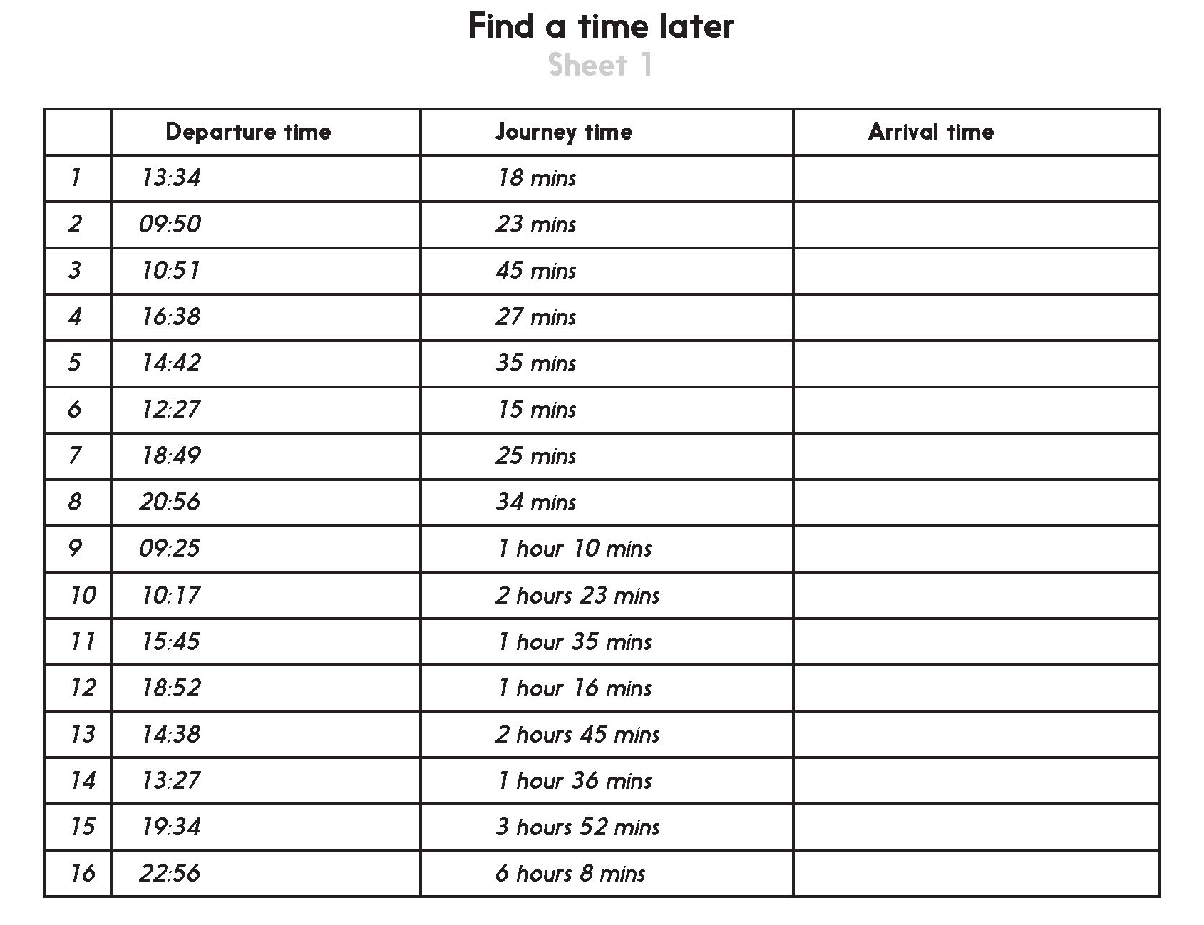
Notes:
The Practice Sheet on this slide is suitable for most children.
Differentiated PRACTICE WORKSHEETS are available on Hamilton’s website in this unit’s PROCEDURAL FLUENCY box.
WT/ARE/GD: Given start times and an elapsed time, find journey end times (Sheet 1).

Slide 10

Measures and Data
Read timetables using 24-hour clock
Calculate time intervals
Well Done! You’ve completed this unit.
Objectives
Day 1
Calculate time intervals using the 24-hour clock
Day 2
Read timetables and calculate time intervals using the 24-hour clock
Day 3
Read timetables using the 24-hour clock. Calculate time intervals.
Day 4
Given a time delay, count on to find new train departure and arrival times.
Notes:
You can now use the Mastery: Reasoning and Problem-Solving questions to assess children’s success across this unit. Go to the next slide.

Slide 11
Problem solving and reasoning questions
True or false?
• 13:40 is twenty to two in the afternoon.
• Midnight is 00:00
• Midday is 12:00 on 24 hour clock
• 19:15 is quarter past 7 in the morning.
• 1 hour after 15:00 is six o’clock pm.
Calculate how long it is between…
• 13:40 and five to 5 in the afternoon
• Quarter to midday and 17:23
• Five past midnight and ten to midday
If each bus is 40 minutes late, write its new arrival time.
(i) No. 31 bus due at 12:55
(ii) No. 22 bus due at 13:04
(iii) No. 15 bus due at 14:44
The number 4A bus arrived 27 minutes late at 00:14. What time was it due?

Slide 12
Problem solving and reasoning: Answers
True or false?
• 13:40 is twenty to two in the afternoon. True
• Midnight is 00:00 True
• Midday is 12:00 on 24 hour clock True
• 19:15 is quarter past 7 in the morning. False - it is in the evening
• 1 hour after 15:00 is six o’clock pm. False - it is four o’clock pm
Calculate how long it is between…
• 13:40 and five to 5 in the afternoon 3 hours 15 minutes
• Quarter to midday and 17:23 5 hours and 38 minutes
• Five past midnight and ten to midday 11 hours and 45 minutes.
An ENL jotting can help with these calculations, which are probably best-solved by counting up from the earlier to the later time.
If each bus is 40 minutes late, write its new arrival time.
(i) No. 31 bus due at 12:55 13:35
(ii) No. 22 bus due at 13:04 13:44
No. 15 bus due at 14:44 15:24
Answers of 12:95 and 14:84 for (i) and (iii) respectively suggest child had added the minutes but forgotten that there are only 60mins in an hour.
The number 4A bus arrived 27 minutes late at 00:14. What time was it due?
23:47

